Slide 1
Bank churn analysis using Python
Suneeth Ravilla
Bowling Green State University

Slide 2
Goal behind analysis
Churn is generally defined as a customer who stops using a product or service for a given period of time.
Customer churn is a major problem of customers leaving your products/subscription and moving to another service.
Banking is one of the highly competitive sector where customer relations is of the utmost importance for any bank.
Marketing costs to acquire new customers are high. Therefore, it is important to retain customers so that the initial investment is not wasted.
Aim of this analysis is to develop a model to predict the probability of a customer is likely to discontinue and preventing customer churn.

Slide 3
About dataset
Dataset contains 10,000 observations of bank customers with 14 variables, numerical variables are 7, categorical variables are 4, and Boolean variables are 3.
RowNumber : Row Numbers from 1 to 10000
CustomerId : Unique Ids for bank customer identification
Surname : Customer's last name
Geography: The country from which the customer belongs
Gender : Male or Female
Age : Age of the customer
EstimatedSalary : Estimated salary of the customer in Dollars
CreditScore : Credit score of the customer
Tenure : Number of years for which the customer has been with the bank
Balance : Bank balance of the customer
NumOfProducts : Number of bank products the customer is utilizing
HasCrCard : Binary Flag for whether the customer holds a credit card with the bank or not
IsActiveMember : Binary Flag for whether the customer is an active member with the bank or not
Exited : Binary flag 1 if the customer closed account with bank and 0 if the customer is retained

Slide 4
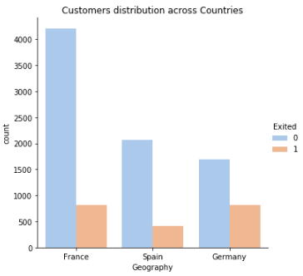
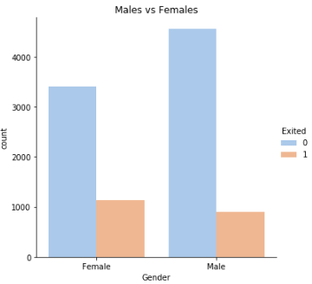
Exploring Data
In data there are three countries, France, Spain and Germany
Here, Exited means the customer has left the bank
France has most number of customers in the data
Even though France and Germany has same amount of churn, Germany has most churn when compared with total number of customers with other two countries.
The proportion of churned customers is inversely related to the population of customers, indirectly the bank possibly having a problem in the areas where it has fewer clients.
Male customers are high compared with female.
Comparing the churn data among male and female customers, female customers are most likely to get churn than male customers.

Slide 5
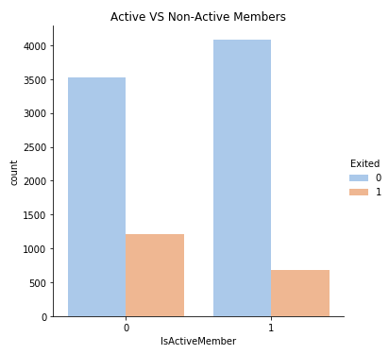
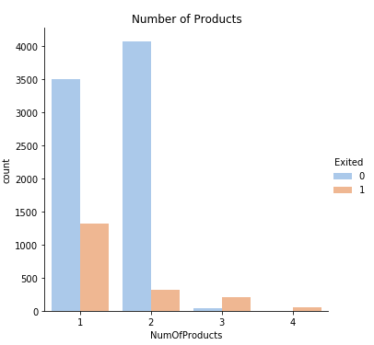
Exploring Data
Customer who is currently having back account but does not perform any transactions from some period of time is considered as in-active and vice versa.
Comparing number of customers who has exited, Customers who are not active has exited more in number.
Comparing non exited vs active member (Blue bar) we can see that more than 40% of the customers are in-active state which means there are likely to get churned.
Products means number of services a customer posses in a bank.
Customer enrolling at least 2 products are high in number and their exit level is very low.
But customer enrolling to only one service has high chance of getting churned.

Slide 6
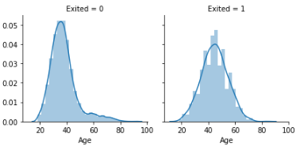
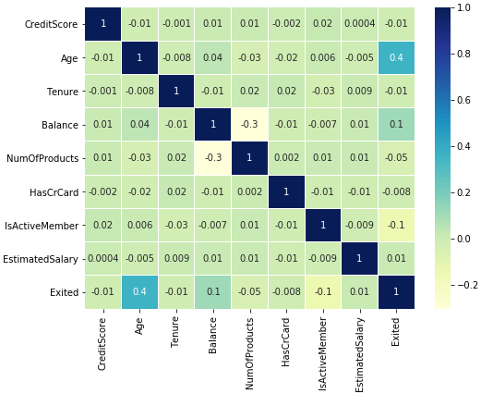
Exploring Data
We can see the Age distribution when people exited from bank. Most of the customers started to churn from 40’s.
At the same time we can see more number of customers present in the back from Age 30 to 40
It seems younger customers tend to stick with the company more compared to older customers.
From correlation matrix, there is no much correlation among the variables which shows very low correlation.
The highest positive correlation is 0.4 that is between Age and Exited.
The highest negative correlation is -0.3 that is between Balance and number of products.

Slide 7

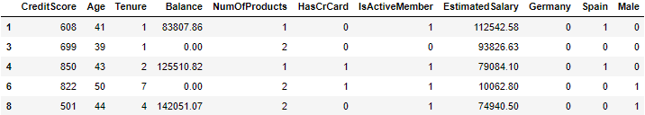

Data Pre-processing
Row number is not required for our analysis.
Customer Id is not required
Surname has high cardinality and I will remove it from the modelling part.
Geography has 3 categories. Germany, Spain, France. so we need to encode this.
Gender is categorical and has two categories and we need to encode this.
Number of products is categorical.
Removing the observations who’s age is greater than 60.
Also dropping the customers who has credit score less than 400.

Slide 8
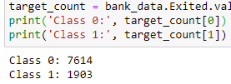
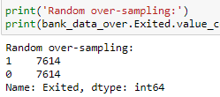
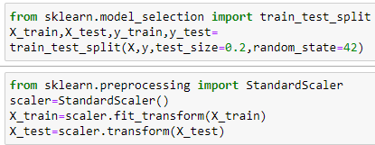
Data preparation for modelling
Our main goal is to predict churn customers i.e. who are likely to exit from the bank.
Upon checking the number of customers who has accounts in bank is 7614 and number of customers who exited the bank is 1903.
Performing over sampling process to make sure the predicted model does not have any sampling error.
Target variable is “Exited” and Independent variables are “Credit score”, “Age”, “Tenure”, “Balance”, “Number of products”, “Has credit card”, “Is active member”, “Estimated salary”.
Partitioning the data randomly into 80% train set and 20% test set.
Scaling the complete data using StandardScaler function.
We need to get the best algorithm which is giving us the best output as predictability. So, we need to try out with various models and then we can select the best ones which will give us the best performance based on accuracy.

Slide 9
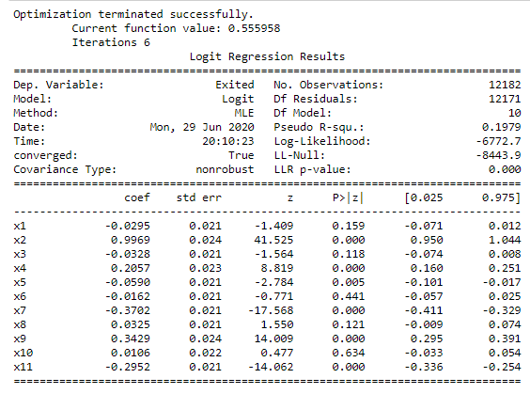
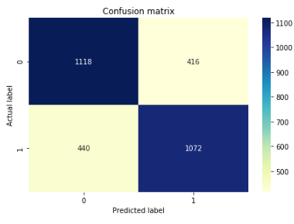
Logistic regression model
Logistic model is build to predict the response variable “Exited”.
Almost all the variables are significant to the model expect variable x6 and x10 where x6 represents whether customer is active or not and x10 represents the country Spain.
The fitted model is then used for prediction and from the confusion matrix we can say that the model has predicted with an accuracy of 71%
Out of 3046 customers, the model has predicted 1118 customers are likely to be exited from the bank.
By checking the ROC, the model indicates that 72% of the time a randomly selected pair of subjects will be correctly predicted by the model.

Slide 10
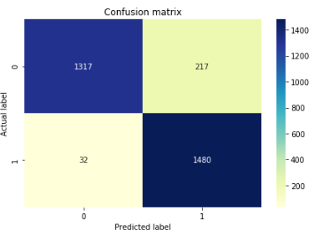
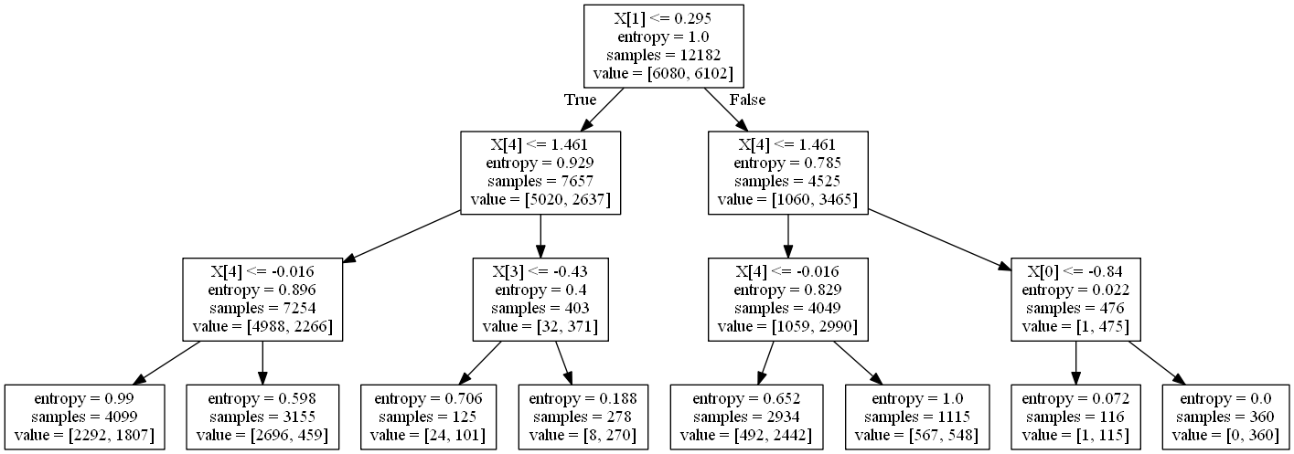
Decision tree model
Decision tree is build to predict the response variable “Exited”.
The model starts with X1 variable splitting if the value is less than 0.295. Here X1 is credit score the value is less because it is scaled in pre-processing
The fitted model is then used for prediction and from the confusion matrix we can say that the model has predicted with an accuracy of 91%
Out of 3046 customers, the model has predicted 1317 customers are likely to be exited from the bank. Which is nearly half number of customers in the test set.
By checking the ROC, the model indicates that 92%
of the time a randomly selected pair
of subjects will be correctly predicted
by the model.

Slide 11
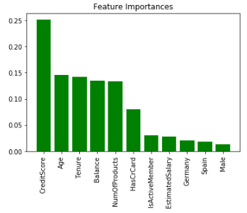
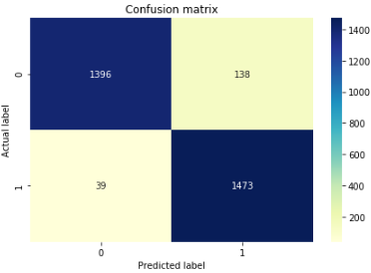
Random forest model
Random forest model is build to predict the response variable “Exited” and also to check the feature importance.
From the feature importance graph, we can see that Credit score is the most contributing feature to the model then followed with Age, Tenure, Balance and no of products.
The fitted model is then used for prediction and from the confusion matrix we can say that the model has predicted with an accuracy of 94%
Out of 3046 customers, the model has predicted 1396 customers are likely to be exited from the bank which is more than the prediction of decision tree model.
By checking the ROC, the model indicates that 94% of the time a randomly selected pair of subjects will be correctly predicted by the model.

Slide 12
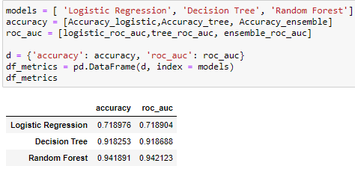
Conclusion
In this analysis of bank customers data, the models were build to predict how likely a customer is going to be exited from the bank.
In exploratory analysis, we found that the ratio of customers churned in Germany is higher than other two countries, also the we found out that the female customer are the most likely to churn and also the customer using only one bank service (product) are likely to get churned.
Almost 40% of the customers are inactive in the bank and the ratio of exiting the bank for inactive members is high.
After building several model we ended up with Random Forest which performed better than others. The accuracy of Random forest and decision tree is higher but Random forest is best with 94%. It has classified 1473 as good customers and 1396 customers are likely to be exited from the bank. Using most efficient metric ROC the model indicates that 94% of the time the model will predict correctly.

Slide 13
THANK YOU !
ANY QUESTIONS ?

